Slide 1
MAPD722
Final Project
Medical Clinic App
Group 9
Quoc Phong Ngo 301148406
Saif Khalid Ahmadzai 301213727

Slide 2
Github
Source code Angular: https://github.com/phongnq2712/mapd722_group9_finalProject
NodeJS server:
https://github.com/phongnq2712/mapd722_group9_nodejs

Slide 3

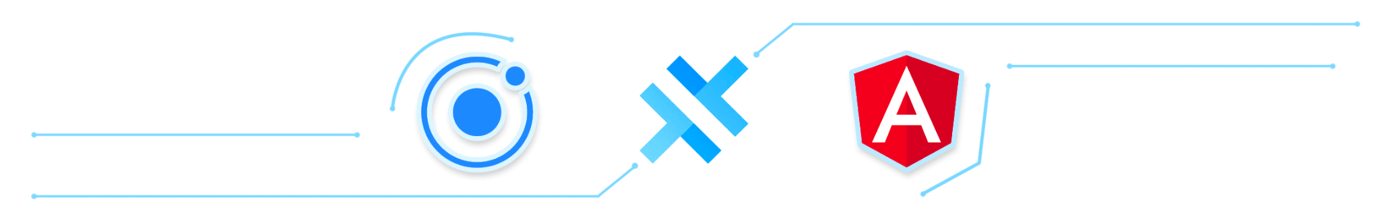

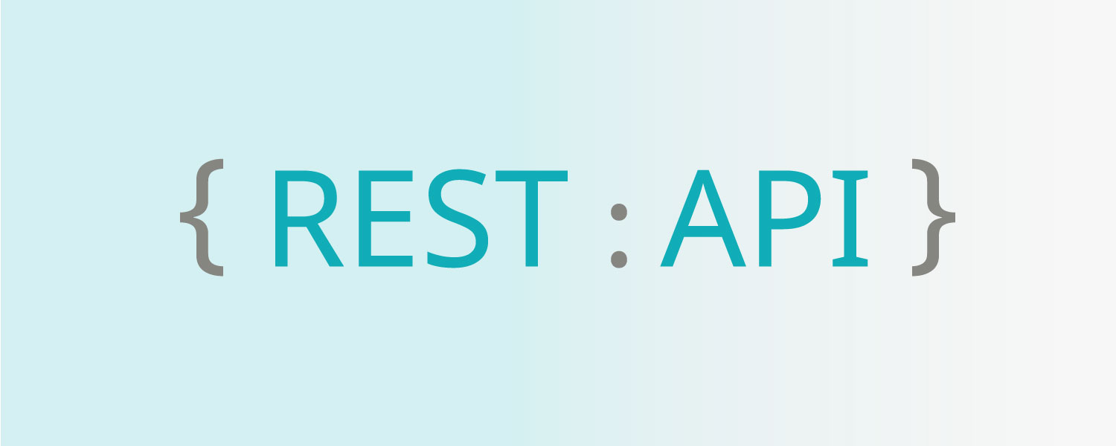
Description
Design a hybrid application for the health care providers.
This app was built by Ionic framework with Angular.
List of technology used:
Angular, JSON, XML, REST API Service, MongoDB, Postman…

Slide 4
List of functions
User:
Register a new account, login, get information of a user to display in Profile tab.
Task:
Create new task for a user, delete task, get all tasks of a user, get a specific task of user, update a task.
Patient:
Get all patients, get information of a specific patient, add a new patient’s info, delete a patient.
Patient’s records: get a clinical records’ patient, create a new clinical records’ patient, delete a clinical records’ patient, update a clinical records’ patient.

Slide 5
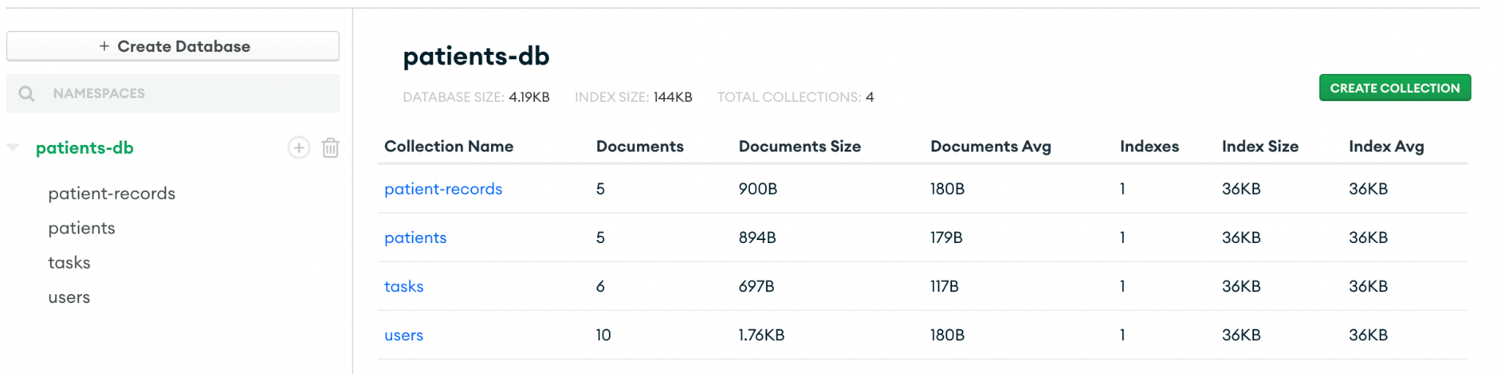
MongoDB Structures

Slide 6
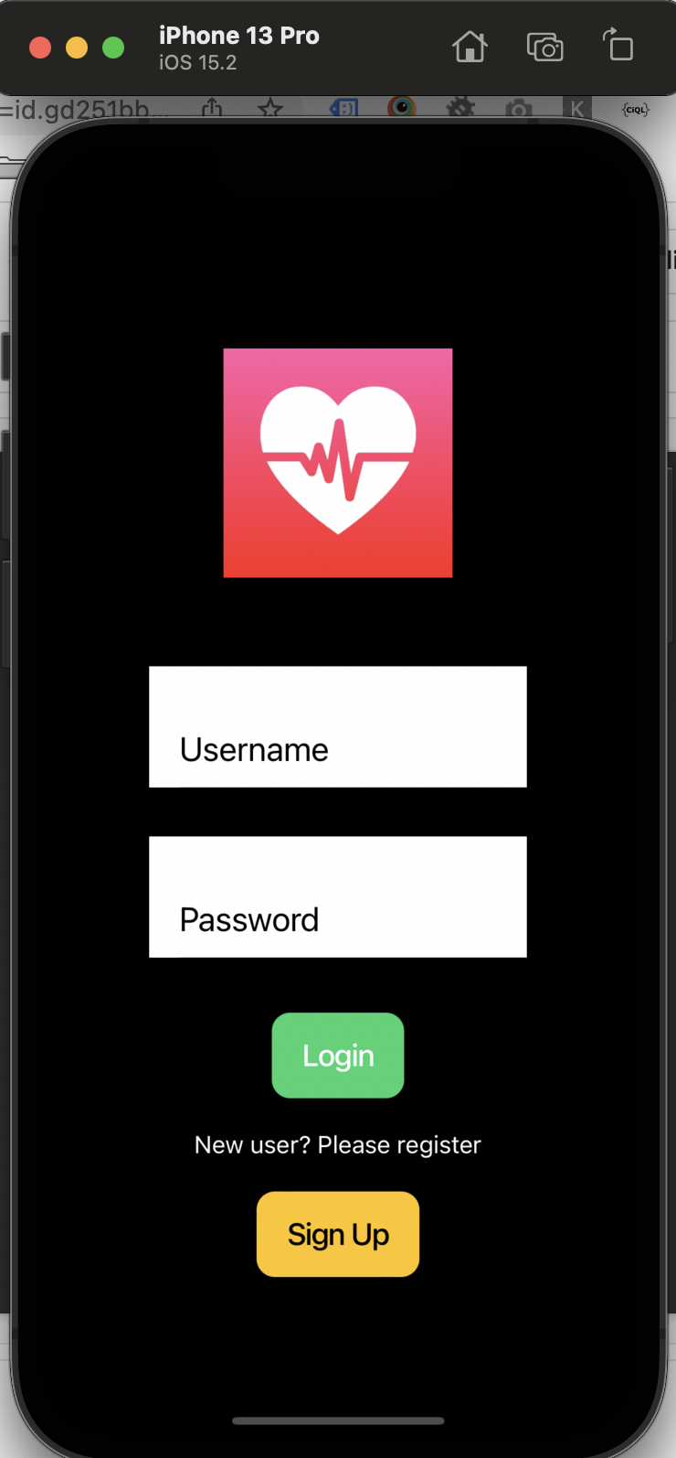
Login screen
Username
Password
Login button
SignUp button

Slide 7
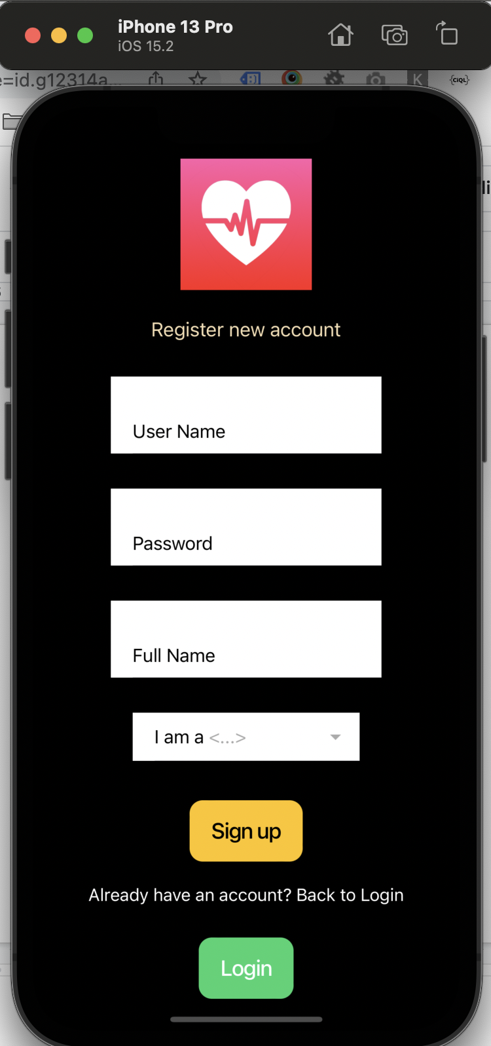
Sign up screen
Username
Password
Full name
Position (doctor, nurse)
SignUp button
Login button

Slide 8
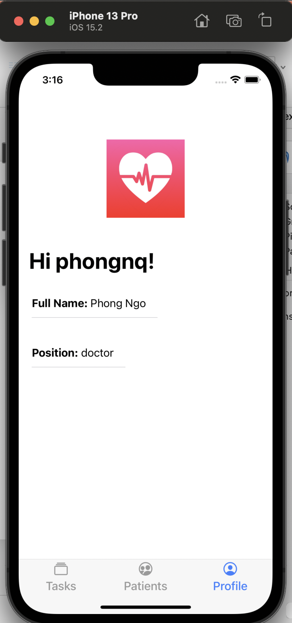
Profile tab
A welcome text message
Full name
Position

Slide 9
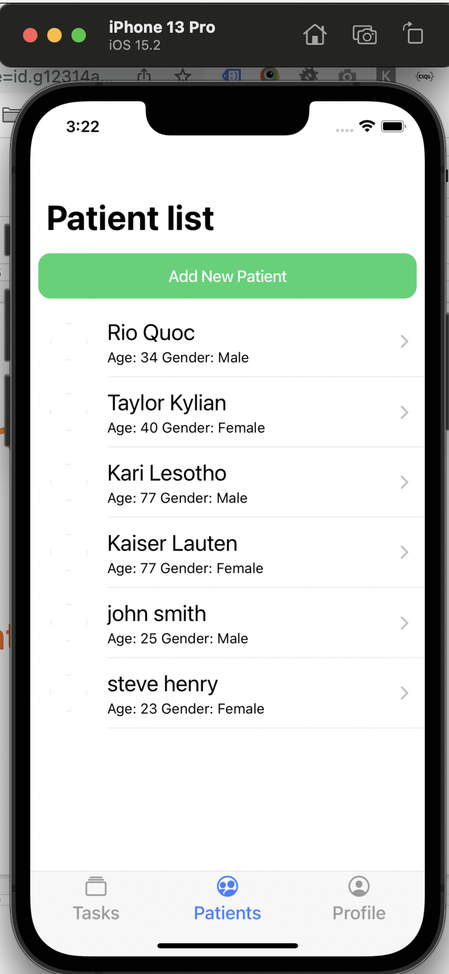
Patient tab
List of patients screen
GET method:
hostname:port/patients

Slide 10
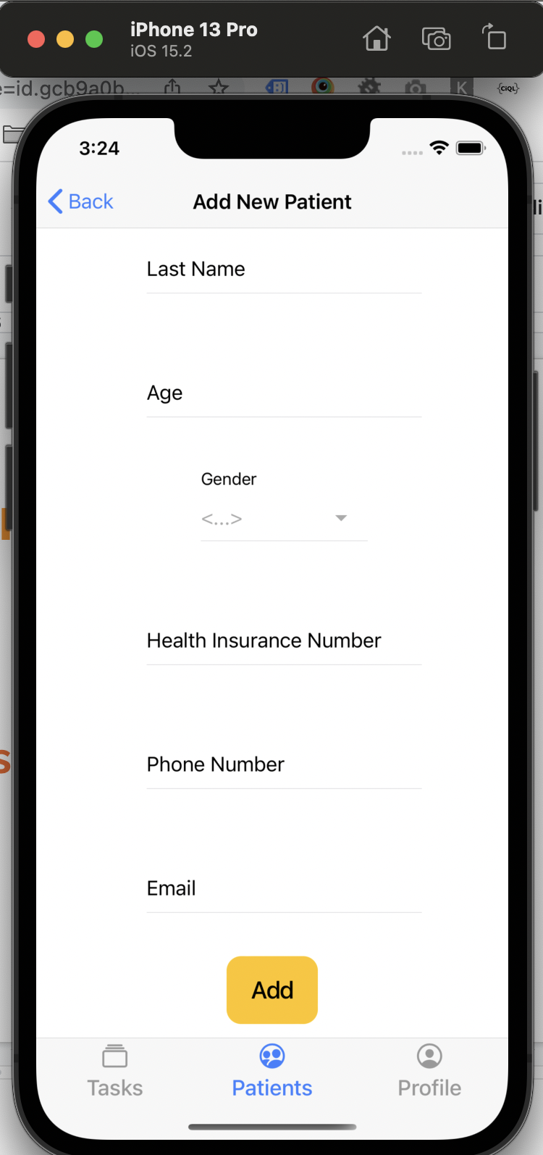
Patient tab
Add new patient screen
POST method:
hostname:port/patients

Slide 11
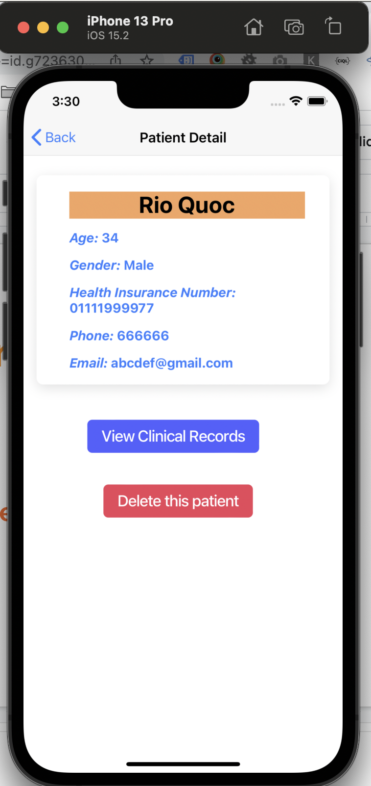
Patient tab
Get a patient screen
GET method:
hostname:port/patients/:patientId

Slide 12
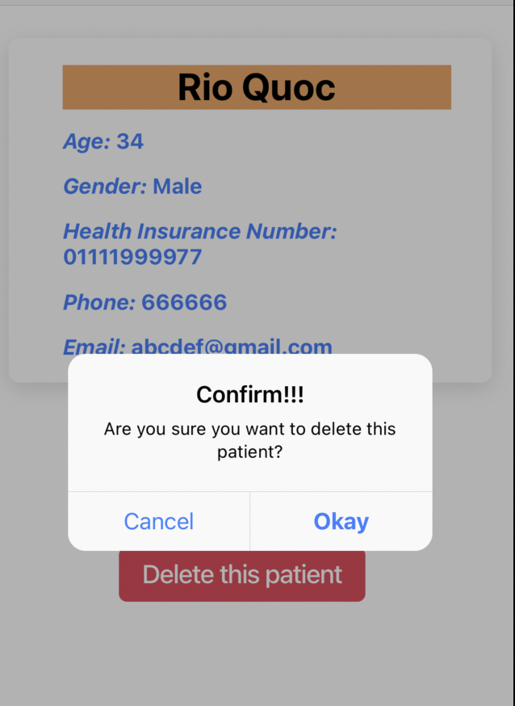
Patient tab
Delete a patient screen
DELETE method:
hostname:port/patients/:patientId

Slide 13
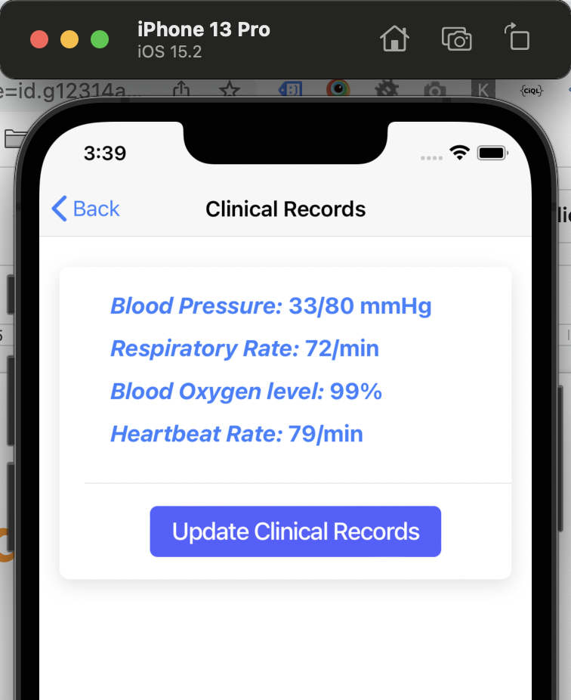
Patient tab
Get a clinical records’ patient screen
GET method:
hostname:port/patients/:patientId/ clinical-records

Slide 14
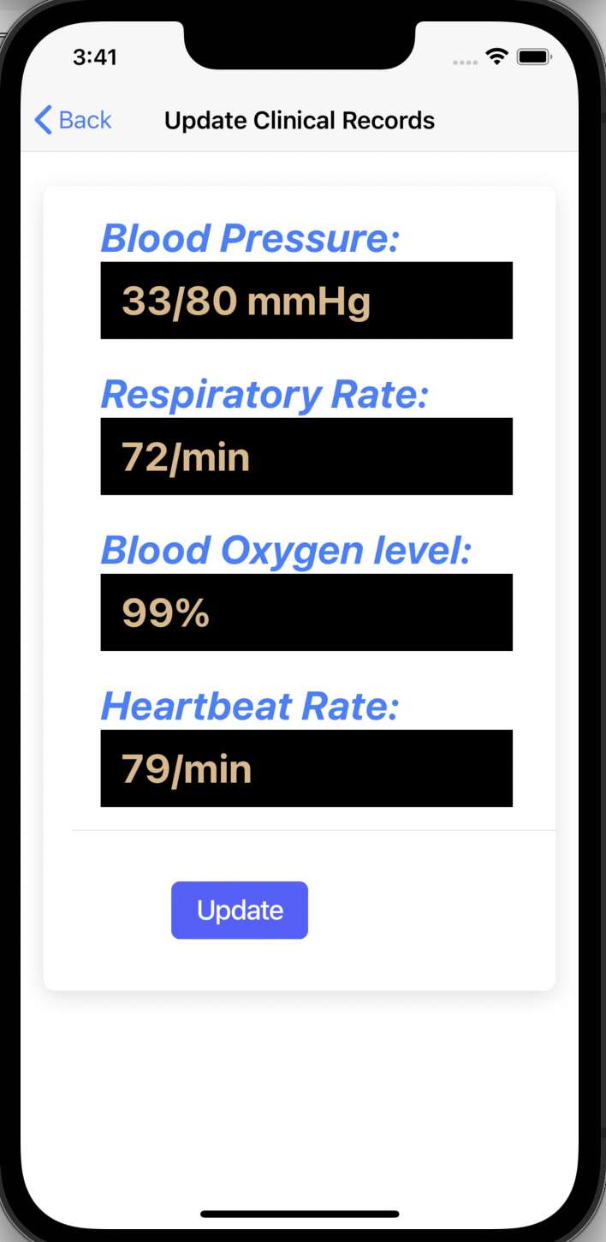
Patient tab
Update a clinical records’ patient screen
PUT method:
hostname:port/patients/:patientId/ clinical-records/:clinicalRecordsId

Slide 15
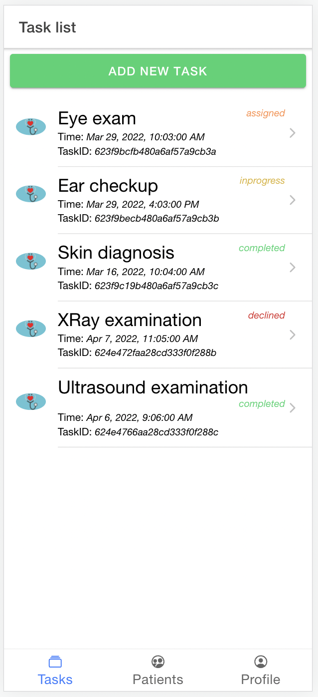
Task tab
List of tasks screen
GET method:
hostname:port/tasks

Slide 16
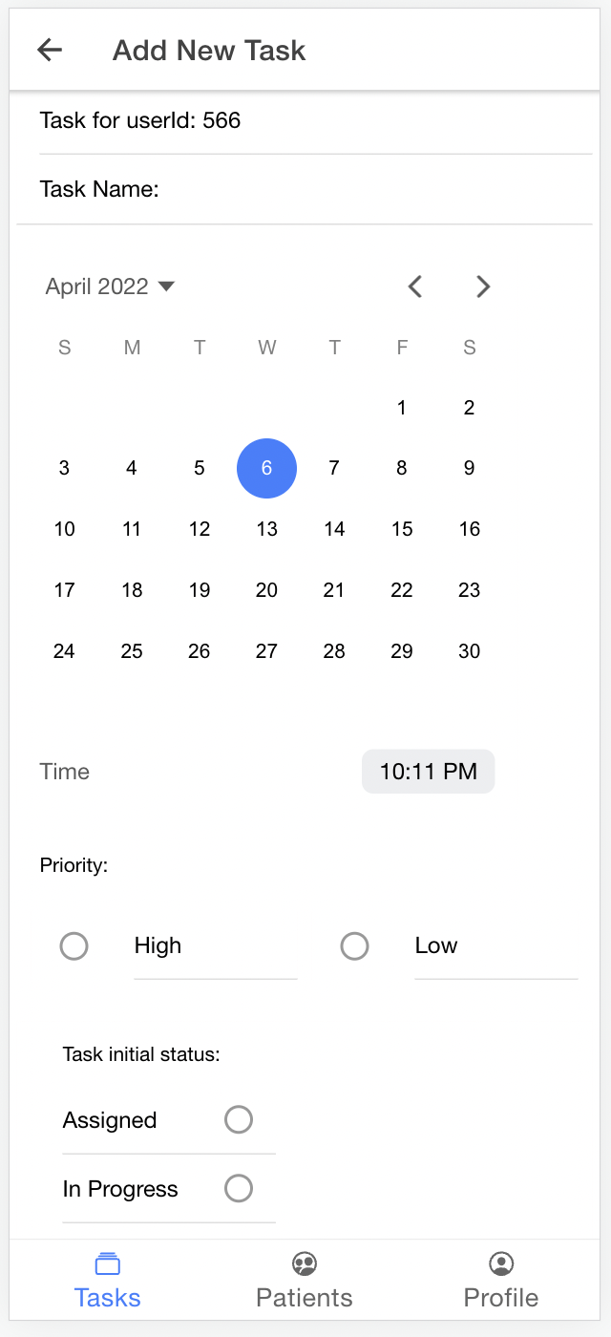
Task tab
Add a new task screen
POST method:
hostname:port/tasks

Slide 17
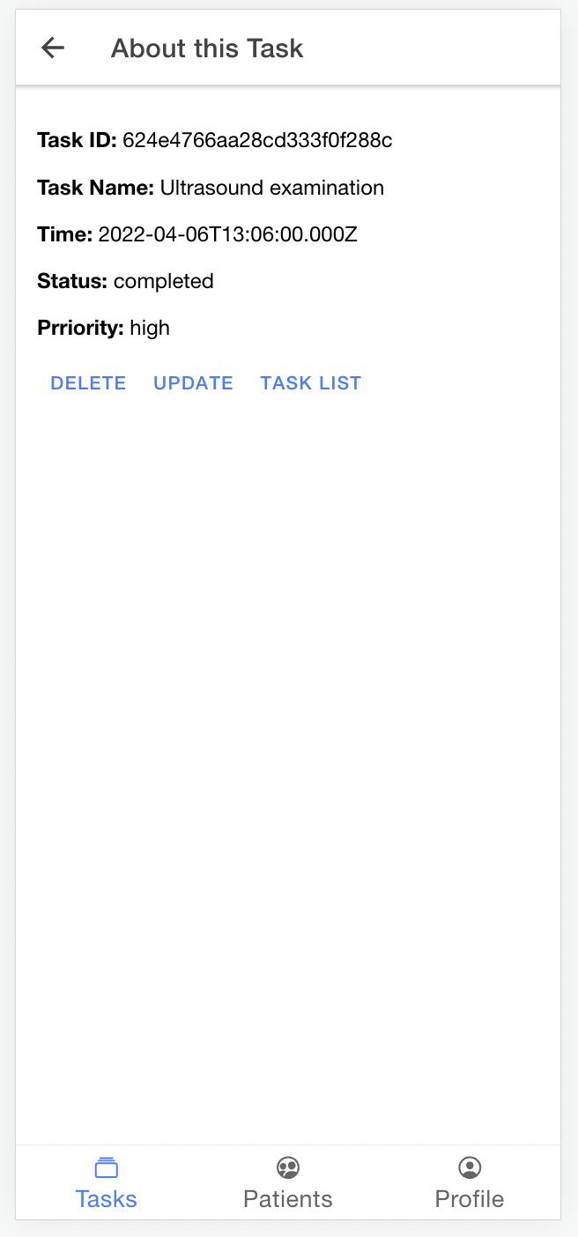
Task tab
Get a task detail screen
GET method:
hostname:port/tasks/:taskId

Slide 18
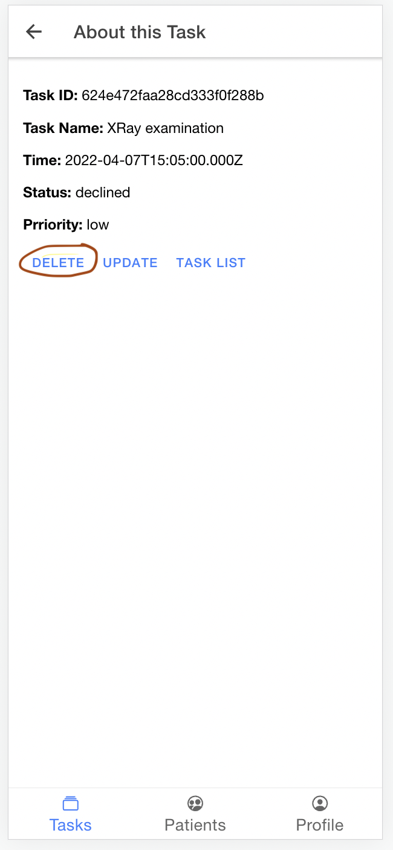
Task tab
Delete a task screen
DELETE method:
hostname:port/tasks/:tasktId

Slide 19
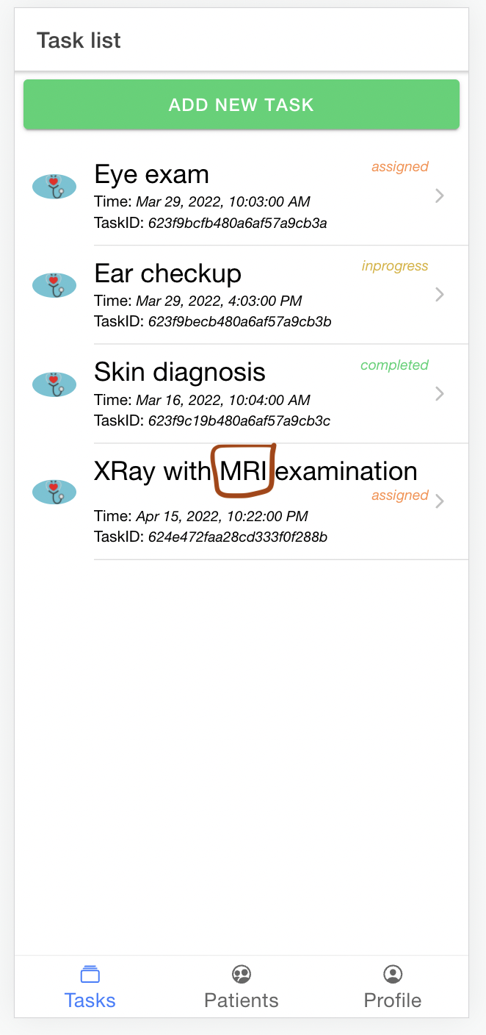
Task tab
Get a task list details
screen
GET method:
hostname:port/tasks/: tasktId

Slide 20
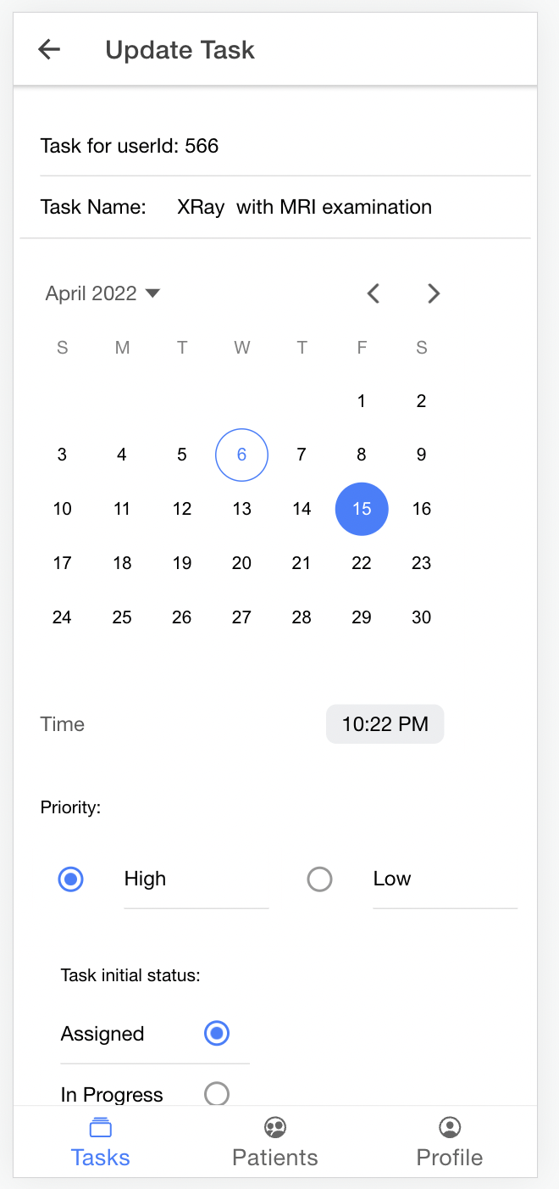
Task tab
Update a task screen
PUT method:
hostname:port/tasks/:taskId

Slide 21

Thank you for your listening!

